Slide 1
College of Medicine Examination System (Pamantasan ng Lungsod ng Maynila)

Slide 2
Historical Background
Pamantasan ng Lungsod ng Maynila & College of Medicine

Slide 3

Pamantasan ng Lungsod ng Maynila
Started during the Administration of Mayor Arsenio Lacson (1957)
Ordinance # 4202 was approved by Mayor Lacson on 13th of January 1960.
1 million pesos was allocated for the university to be established.
Counselor Ernesto Maceda chaired the Board’s Committee that allocated funds for the creation of the city of university.
After Mayor Lacson passed away the fulfillment of his dream university was continued by his Vice Mayor Antonio Villegas.
Executive Order # 7 , s-1963, was issued by Mayor Villegas in creating a plan and working a committee.
Pres. Diosdado Macapagal signed into law the final bill “An Act Authorizing the City of Manila to Establish and Operate the University of the City of Manila and for Other Purposes” on June 19,1965.

Slide 4

College of Medicine
Established in June 1983 with 48 medical scholars.
Board of Regents passed the Resolution #806, s-1980 on December 15,1980.
The College will offer a unique, community- based medical education that will serve the health needs of the City of Manila.
At the beginning of the program, students finished a pre-medicine course and have met the necessary requirements.
3 years after they opened its doors to qualified non-manila residents.
Upon graduation students interned at Ospital ng Maynila Medical Center.
After they passed the medical board examination and obtained their license to practice they served to Gov’t Hospitals of Manila and as a faculty members of College of Medicine.
Through the years the PLM College of Medicine has gained recognition and respect as one of the premier medical schools in Philippines.
The College is consistently in the Philippine Regulations Commission’s List of top 5 colleges.

Slide 5
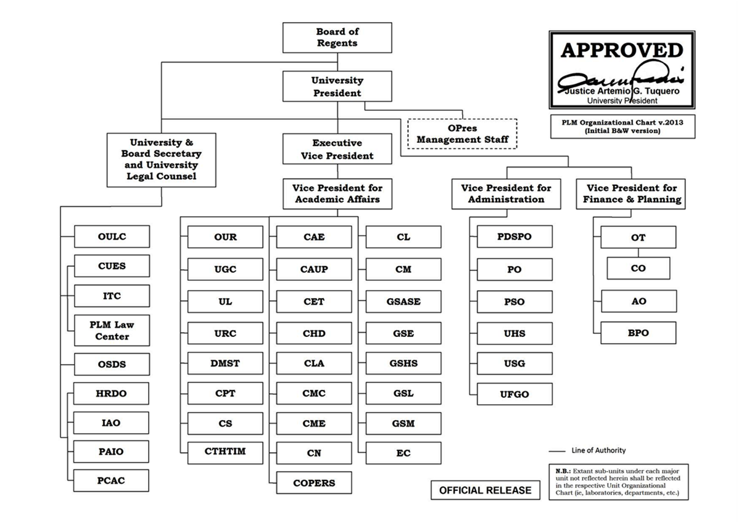
Organizational Chart (PLM)

Slide 6
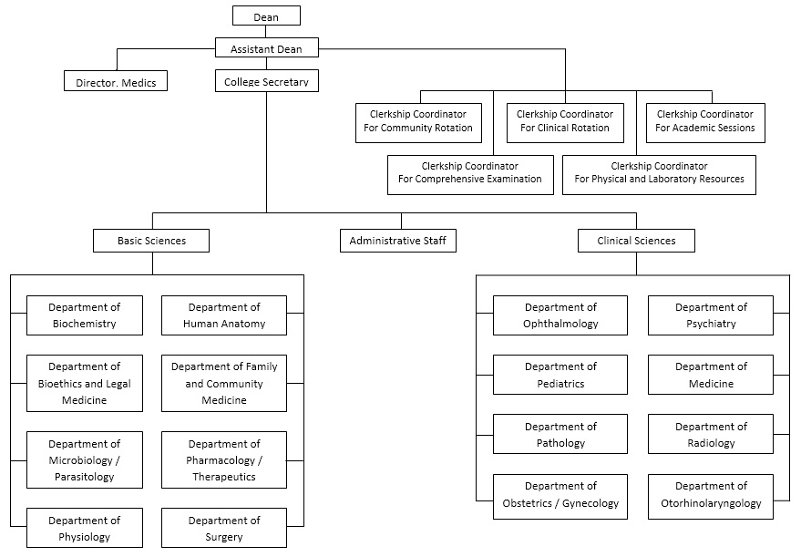
Division Under Study (College of Medicine)

Slide 7
Existing System Flow

Slide 8




1. Generation of Questionnaire Draft
1.1
Distribution of Objective of the Blueprint
FACULTY
1.3
Compare each questions with the previous shifting exams
CHAIRMAN
1.2
Create questions based on the textbooks
Textbooks
Previous Shifting Exam

Slide 9

1.6
Final Questionnaire Draft
CHAIRMAN
FACULTY
1.4
Search the item number on the preferred shifting exam
1.5
Determine the validity of the questions
Previous Shifting Exam
Item Analysis

Slide 10

2. Generation of Official Questionnaire
2.4
Official Questionnaire
2.1
Consolidate all the questionnaire drafts
CHAIRMAN
2.2
Compare each questions from
the previous shifting exam
FACULTY
2.3
Determine the validity of the question
Questionnaire
Drafts
Previous Shifting Exam
Item Analysis

Slide 11


3.1
Official Questionnaire and Scantron sheet
3.2
Official Questionnaire and Answered Scantron sheet
FACULTY
STUDENT
3.3
Answered
Scantron Sheet and Answer key
Scantron Machine
3. EXAMINATION PROPER

Slide 12


4.2
Item Analysis, Scores
DEAN
4.2
Item Analysis,
Score
MEDICS Director
4.1
Item Analysis,
Score
4.2
Item Analysis,
Score
Scantron Machine
FACULTY
4.2
Score
CHAIRMAN
4. Generation and Distribution
Of Reports
STUDENT

Slide 13
[Context Diagram]
ES → C, D & M: Item Analysis
S → ES: Answered Scantron sheet
ES → C: Questionnaire Draft
ES → S: Official Questionnaire
ES → C: Blueprint
C → ES: Official Questionnaire
C → ES: Objective of the Blueprint
M → ES → S: Course Outline
ES → C, D & S: Scores
ES → S: Scantron Sheet
S → ES: Official Questionnaire

Slide 14
Statement of the problem :

Slide 15
Time Consuming on Generating Official Questionnaire
1

Slide 16
Documents involved :
Blueprint Outline – guidelines in determining the type of questions whether they fall under remembering, understanding, application, analysis, evaluation or creation.
Textbooks – official reference used on creating questions.
Questionnaire draft - list of questions created by the faculty.
Blueprint – constructed structure of the questionnaire draft.
Official Questionnaire – questionnaire used for the examination.
Item Analysis - result of the examination including the difficulty index, discrimination index, mean, standard deviation, reliability index and standard error.

Slide 17
Scenario(1-3) :
Every year the College of Medicine conducts four shifting exams in each department. Each department delegates three to five faculties to create a questionnaire draft. Usually the draft consists up to 100 to 200 questions. Each and every shifting exams the faculty will likely start from the scratch. Each faculty has to base his or her questions on the objective of the blueprint given to him or her by the chairman then compare each question to the previous shifting exam if it existed.

Slide 18
Scenario(2-3) :
If the question existed on the previous shifting exam, the faculty needs to determine its validity. If the question is valid, the question will remain but when it is invalid, the question will be revised or removed. After gathering the questions the faculty will determine which type the question falls into and he or she has to do this to all the questions. When they finished creating the questionnaire draft they will submit it to the chairman of their department. The chairman cannot start evaluating the questions until all faculties submitted their drafts.

Slide 19
Scenario(3-3) :
After consolidating all questionnaire drafts from the faculty, the chairman will evaluate and review all the questions submitted and further check their validity to ensure the reliability of the question. After evaluating and reviewing all the question, the chairman will gather questions for generating the official questionnaire. Lastly, if the official questionnaire was created it will be printed and distributed to the faculty for examination proper.

Slide 20
Cause Impact
Each faculty starts from scratch every time they create a questionnaire draft.
Each question needs to be checked if it existed on the previous exam.
Same process is done between faculty and chairman.
Time for other work was spent on generating the exams.

Slide 21
Hours allotted for working | 4 hours
GENERATING QUESTIONNAIRE DRAFT:
Gather possible questions and determining its type | 1 min x 100 = 100 minutes or 1 hour and 40 minutes
Typing the gathered questions | 2 min x 100 = 200 minutes or 3 hours and 20 minutes

Slide 22
Time spent on validating each questions = 254 minutes or 4 hours & 14 minutes
Time it takes to retrieve previous shifting exam | 2 minutes
Time it takes to retrieve previous item analysis | 2 minutes
Time it takes to search the preferred question | 2 minutes
Time it takes to determine the validity of the preferred question | 1 minute
Total time to retrieve the validity of the first question | 2+2+2+1 = 7 minutes
Total time it takes to check the validity of 100 questions | 7+((2+1)*99) = 304 minutes or 5 hours and 4 minutes
Total time it takes to check the validity of 100 questions but doesn’t exist on the previous shifting exam | (2+2+2)+(2*99) = 204 minutes or 3 hours and 24 minutes
Average time of checking the validity of the existing and non-existing questions | (304+204)/2 = 254 minutes or 4 hours and 14 minutes

Slide 23
Finalizing the Questionnaire Draft = 50 minutes
Finalizing the questions and revisions | 30 minutes
Satisfying the Objective of the Blueprint and revision of questions | 20 minutes
Total time on Generating the Questionnaire Draft | 100 + 200 + 254 + 30 + 20 = 604 minutes or 10 hours and 4 minutes
Days Spent on Generating the Questionnaire Draft | 10 hours and 4 minutes/ 4 hours = 2.52 days (AVERAGE) 3 days
Days it take to generate official questionnaire | 604+(3*254)+30+20 = 1416 minutes/4 hours = 5.9 days (AVERAGE) 6 days

Slide 24
Inaccurate Report on the Item Analysis
2

Slide 25
Documents involved:
Item analysis - result of the examination including the difficulty index, discrimination index, mean, standard deviation, reliability index and standard error.

Slide 26
Scenario(1-2):
After the examination proper, the chairman, dean and MEDICS director evaluates the examination using the item analysis generated by the scantron machine. They review the results of the examination like the; scores, mean, standard deviation, reliability index and standard error for analyzing its efficiency and determine whether the examination satisfies the blueprint’s objective or not.

Slide 27
Scenario(2-2):
The higher officials (chairman, dean and MEDICS director) usually don’t rely on the results of the reliability index because they prefer the results of the standard method in which they do it manually but they don’t want to manually compute the analysis because the process is time consuming. The acceptable index of the standard method for reliability index is from .70 and above. Meanwhile, the acceptable index for the existing system’s reliability index range down from .60 and above.

Slide 28
Cause Impact
Existing item analysis doesn’t use the standard computations
Poor evaluation of the examination

Slide 29
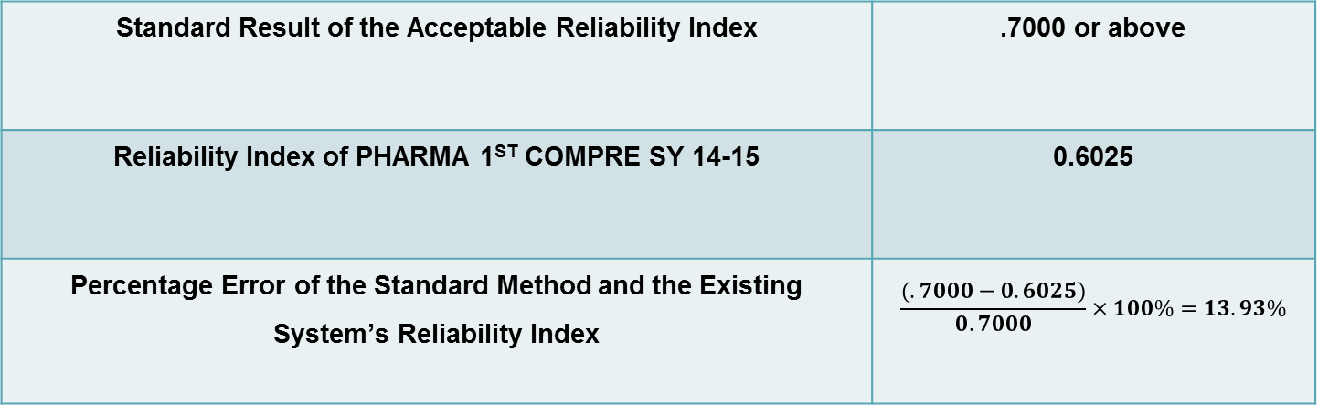
Quantification :
Standard Result of the Acceptable Reliability Index | .7000 or above
Reliability Index of PHARMA 1ST COMPRE SY 14-15 | 0.6025
Percentage Error of the Standard Method and the Existing System’s Reliability Index | $$\frac{(.7000−0.6025)}{0.7000}×100\%=13.93\%$$

Slide 30
Incomplete Statistical Report
3

Slide 31
Documents involved:
Item analysis - result of the examination including the difficulty index, discrimination index, mean, standard deviation, reliability index and standard error.

Slide 32
Scenario(1-2):
After the examination, the scantron will generate the statistical analysis which includes the Discrimination index, Difficulty index and Examinee Ranking. The faculty will distribute the reports for documentation to the Dean, MEDICS director and chairman. The students will also receive their scores for them to determine whether they passed or failed.

Slide 33
Scenario(2-2):
The statistical analysis is only for the benefit of the quality of the next examination. The system lacks the information necessary for assessing the further outcome of the future examinations and also for predicting the result of major examinations such as the passing rate of the students for board examinations.

Slide 34
Cause Impact
The system generates result that lacks information to be considered a statistical report.
Unable to track/monitor the progress of the students.
Difficulty to assess the result of the future examinations.

Slide 35
THANKS!
SystematiCS!

